Slide 1


International Political Economy (SOCS-SHU 222)
THE WTO AND THE WORLD TRADE SYSTEM
Instructor: JING QIAN

Slide 2
Welcome new friends!

Slide 3
Logistics
Library workshop this Wednesday
Attendance & tardiness tracking begins this Wednesday
No class on next Monday, Feb 2
Field trip to NDB HQ on Friday, Feb 6
Required readings are now posted on the online syllabus
No Office Hour this Wednesday (email me)

Slide 4
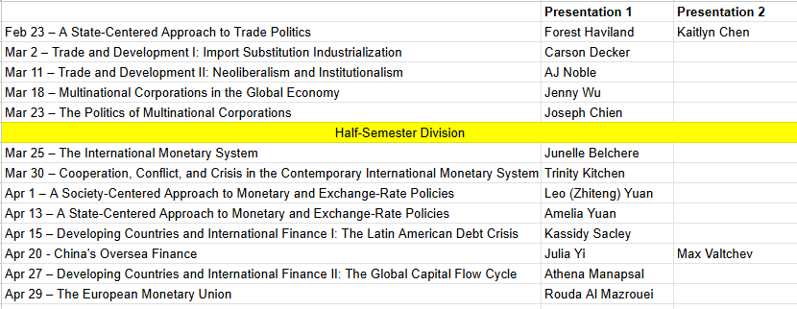
Presentation Schedule
Available at https://jingqian.org/IPEclass/schedule and online syllabus

Slide 5
Let’s continue

Slide 6
The WTO and the World Trade System
READING ASSIGNMENT:
Oatley Chapter 2

Slide 7


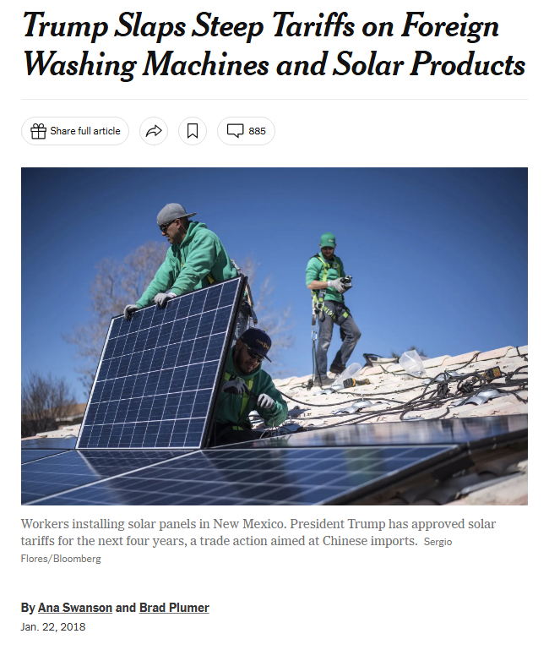
Notes:
https://x.com/nyuniversity/status/1503025886609776651

Slide 8
Why is this even a news?

Slide 9
Anarchy & Sovereignty
But there are still rules…

Slide 10
Countries cannot arbitrarily determine tariffs,
Because…

Slide 11



Slide 12
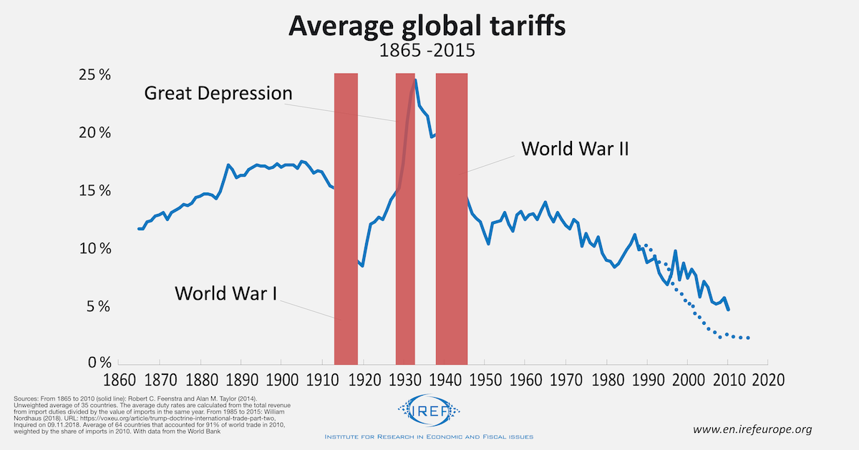
Notes:
https://enirefeurope.b-cdn.net/wp-content/uploads/sites/3/2019/01/average_global_tariffs_1865_2015.png

Slide 13
How to negotiate a world of free trade?

Slide 14
GATT/WTO
Initial idea: International Trade Organization (ITO)
Discussed at the Bretton Woods Conference (1944)
But the ITO Failed
Charter drafted in 1948
United States Congress failed to approve it
Meantime, GATT had been initially formed with 15 countries in 1945

Slide 15
GATT/WTO
GATT: the General Agreement on Tariffs and Trade
Signed in 1947
Entered force in 1948
23 initial members
In 1995, GATT became the World Trade Organization (WTO)

Slide 16
WTO
166 members as of 2024
http://www.wto.org/english/theWTO_e/whatis_e/tif_e/org6_e.htm
Staff of only 623
IMF: ~2000
World Bank: >10,000
2024 Budget: About CHF 200,000,000
http://www.wto.org/english/thewto_e/secre_e/budget_e.htm
World Bank operating budget ~ $1 billion
Total IMF resources approaching 1 trillion…

Slide 17
What does the WTO do?
Provides a forum for negotiations
Administers trade agreements
Provides a dispute settlement mechanism

Slide 18
3 components
A set of principles and rules
An intergovernmental bargaining process
A dispute settlement mechanism

Slide 19
(1) Principles & Rules
Market liberalism
In the aggregate gains from trade outweigh losses
Winners *could* compensate losers
Nondiscrimination
Most Favored Nation (MFN): Treat all countries as well as its favorite trading partner
National treatment: prohibits the use of taxes, regulations, other domestic policies to advantage domestic over foreign firms

Slide 20
MFN exceptions
Generalized System of Preferences (GSP) (from 1960s):
Developed countries can apply lower tariffs for developing countries than for their peers
Regional trade arrangements (RTAs)
Free-trade areas (e.g., NAFTA) ok!
Customs unions (e.g., EU) ok!

Slide 21
(2) Intergovernmental Bargaining Process
Bargain over what?
Tariffs and nontariff barriers
Nontariff barriers? Health & safety regulations, standards (environmental), government purchasing practices, quotas, bans, rules of origin, packaging/labeling conditions, complex regulatory environment, licensing
Antidumping
Intellectual property rights
Textiles, agriculture, services, government procurement, e-commerce…

Slide 22
9 Bargaining Rounds
1947 Geneva
1949 Annecy
1951 Torquay
1956 Geneva
1960-61 Dillon Round
1964-67 Kennedy Round
1973–79 Tokyo Round
1986-93 Uruguay Round
2002-??? The Doha Round
Why are rounds getting longer?

Slide 23
(3) Dispute Settlement Mechanism
“The dispute settlement mechanism ensures compliance by helping governments resolve disputes and by authorizing punishment in the event of noncompliance.” (Oatley textbook, p59)
How do you tie your hands without a rope?
(commitment/enforcement questions)
COSTS OF ESCALATION
AND LEGITIMIZING RETALIATION!

Slide 25
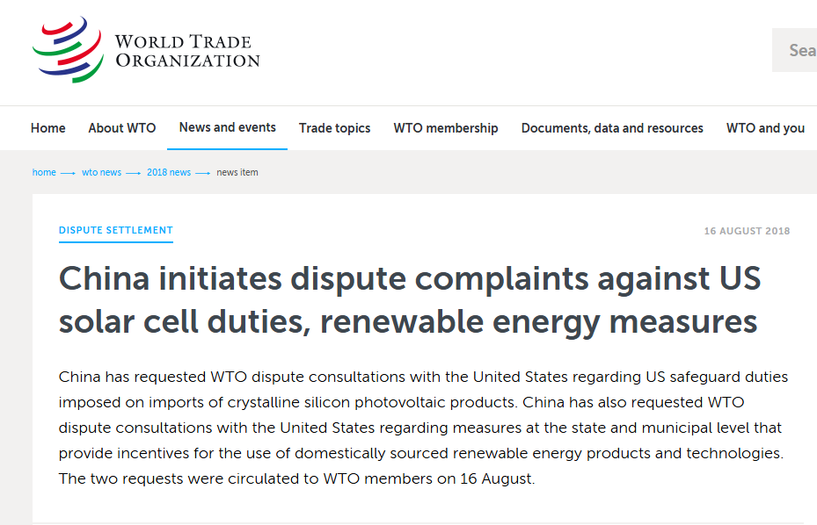
Notes:
https://www.wto.org/english/news_e/news18_e/ds562_563rfc_16aug18_e.htm

Slide 26
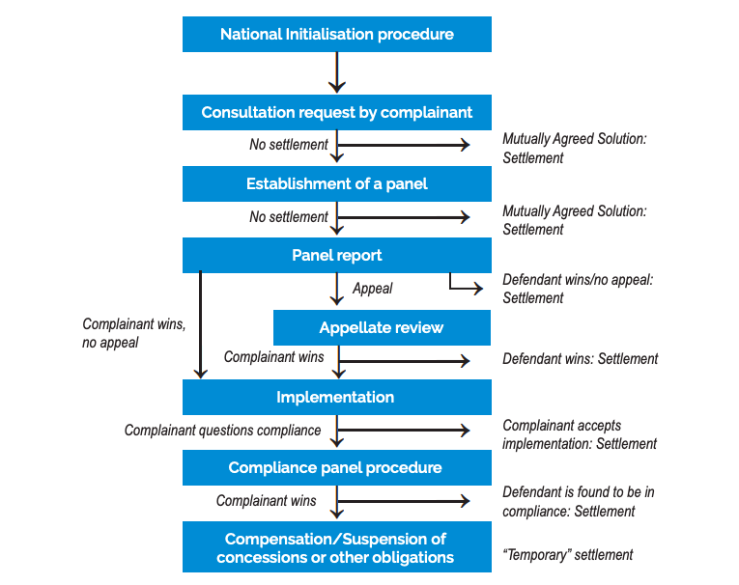
More detailed version from the WTO website
Notes:
https://forumias.com/blog/wp-content/uploads/2022/09/WTO-Dispute-Settlemt.png

Slide 27
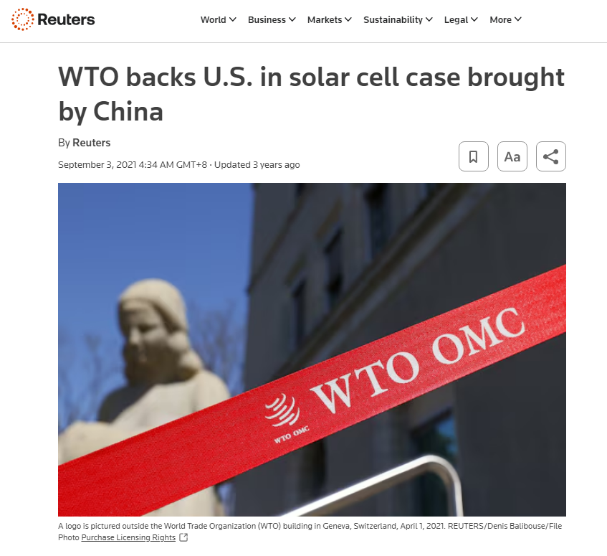
Notes:
https://www.reuters.com/business/wto-backs-us-solar-panel-case-brought-by-china-2021-09-02/

Slide 28
The WTO had great success
Most disputes were resolved BEFORE reaching the level of a panel of judges under the dispute settlement mechanism.
Why?
Foreseeing the punishment, countries tend to resolve the dispute before escalating to an actual panel (deterrence effect)
Precedent-setting and future policy flexibility
But…

Slide 29
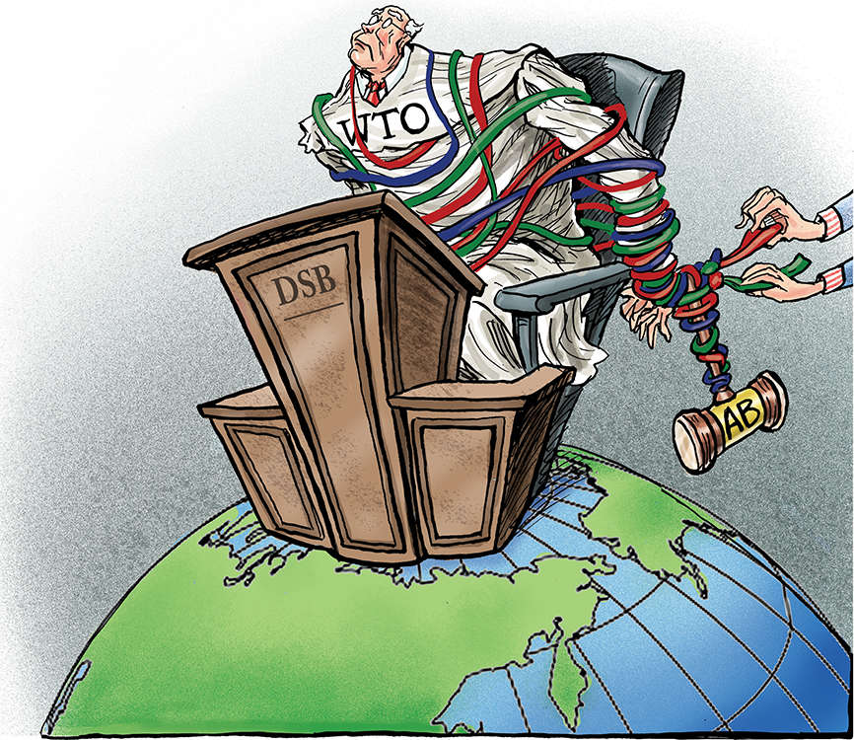
Notes:
https://static.toiimg.com/imagenext/toiblogs/photo/blogs/wp-content/uploads/2021/05/WTOStress.jpg

Slide 30
WTO Appellate Body Crisis
The United States has blocked appointments to the seven-judge Appellate Body
US concerns: WTO exceeding its mandate
Dispute settlement mechanism was forced to shut down in Dec 2019 with only one judge left
On Nov 30, 2020, all Appellate Body judges left the office.
Proposal to start the process of selecting new judges blocked 73 times and counting!

Slide 31
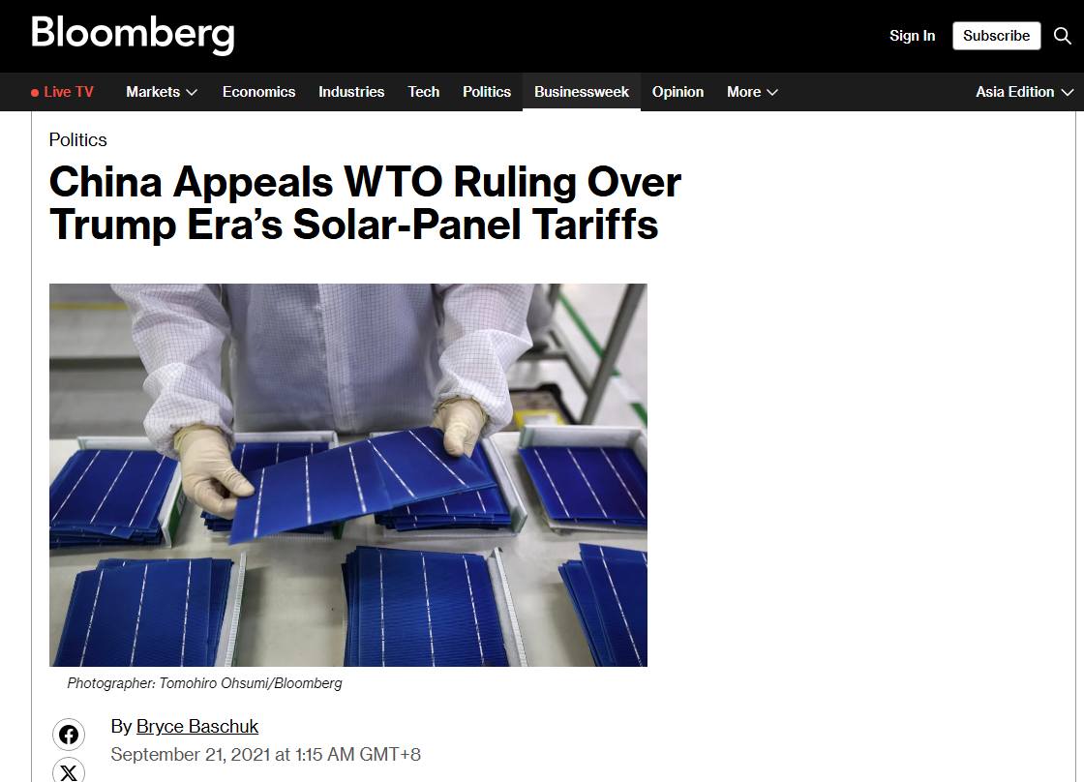
Notes:
https://www.bloomberg.com/news/articles/2021-09-20/china-appeals-wto-dispute-over-trump-era-s-solar-panel-tariffs?embedded-checkout=true

Slide 32
“Appeal into the void”
As a result of the US hold on Appellate Body appointment and reappointment procedures and the expiry of the terms of the Appellate Body members, the Appellate Body is, since December 2019, no longer able to review new or pending appeals. To date, more than 20 panel rulings have been appealed “into the void”, meaning that a resolution of these dispute proceedings is not possible until new Appellate Body members are appointed. All future panel rulings also face the risk of being appealed “into the void” unless a solution is found to the impasse.
Notes:
https://www.wto.org/english/thewto_e/minist_e/mc12_e/briefing_notes_e/bfwtoreform_e.htm

Slide 33
Regional Trade Agreements

Slide 34
RTAs
Free Trade Area (e.g., NAFTA➔ USMCA)
Eliminate tariffs amongst members
Members maintain independent trade policies with non-members
Customs union (e.g., EU)
Eliminate tariffs amongst members
Common tariff policy with non-members
Discriminatory?
Allowed under GATT Article XXIV – as long as tariffs are no higher than the level applied by the countries prior to the arrangement
Currently 373 RTAs in operation https://www.wto.org/english/tratop_e/region_e/region_e.htm
2020: 303 RTAs; 2022: 354; 2023: 355
Most are bilateral (e.g., KORUS)
Most are free trade agreements

Slide 35
Customs Unions
Central American Common Market (CACM)
Andean Community (CAN)
Caribbean Community (CARICOM)
Economic and Monetary Community of Central Africa (CEMAC)
East African Community (EAC)
Eurasian Economic Community (EAEC)
European Economic Area (EEA) (plus EC – Andorra, EC – Turkey)
Gulf Cooperation Council (GCC)
Southern Common Market (MERCOSUR)
Southern African Customs Union (SACU)
West African Economic and Monetary Union (WAEMU)

Slide 36
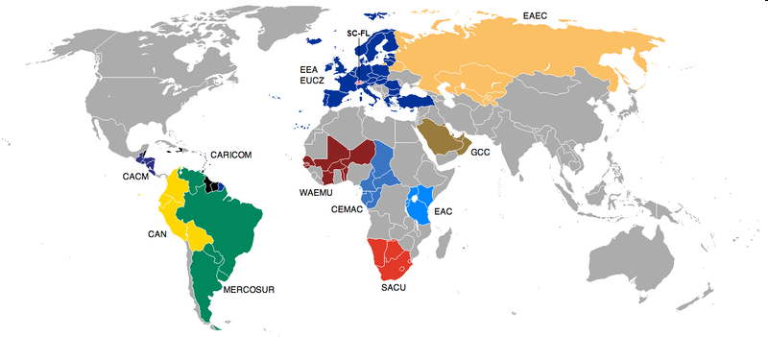
?

Slide 37

Thank You!

Slide 38
Take-away
WTO is a small international organization
Purposes: Provide a negotiation forum, administer trade agreements, provide a dispute settlement mechanism
Chief principles: MFN, Nondiscrimination
Major negotiation issues: tariffs, nontariff barriers, antidumping, intellectual property rights, textiles, agriculture, services
Regarding disputes - most are settled before full escalation
So the WTO does not cast many rulings - but it still may have a big effect as a deterrent
But now the Appellate Body is paralyzed.

Slide 39
Article I: Most Favored Nation (MFN)
Article I
General Most-Favoured Nation Treatment
1. With respect to customs duties and charges of any kind imposed on or in connection with importation or exportation or imposed on the international transfer of payments for imports or exports, and with respect to the method of levying such duties and charges, and with respect to all rules and formalities in connection with importation and exportation, and with respect to all matters referred to in paragraphs 2 and 4 of Article III,* any advantage, favour, privilege or immunity granted by any contracting party to any product originating in or destined for any other country shall be accorded immediately and unconditionally to the like product originating in or destined for the territories of all other contracting parties.
Source: World Trade Organization, Legal Texts

Slide 40
Article III: National Treatment
Article III*
National Treatment on Internal Taxation and Regulation
1. The contracting parties recognize that internal taxes and other internal charges, and laws, regulations and requirements affecting the internal sale, offering for sale, purchase, transportation, distribution or use of products, and internal quantitative regulations requiring the mixture, processing or use of products in specified amounts or proportions, should not be applied to imported or domestic products so as to afford protection to domestic production.*
2. The products of the territory of any contracting party imported into the territory of any other contracting party shall not be subject, directly or indirectly, to internal taxes or other internal charges of any kind in excess of those applied, directly or indirectly, to like domestic products. Moreover, no contracting party shall otherwise apply internal taxes or other internal charges to imported or domestic products in a manner contrary to the principles set forth in paragraph 1.*
Source: World Trade Organization, Legal Texts

Slide 41
Initial GATT members (1/1/1948)
Australia
Belgium
Brazil
Burma
Canada
Ceylon
Chile
China
Cuba
Czechoslovak Republic
France
India
Lebanon
Luxembourg
Netherlands
New Zealand
Norway
Pakistan
Southern Rhodesia
Syria
South Africa
United Kingdom
United States

Slide 42
Forum Shopping (Busch 2007)
RTAs open up venue for forum shopping
Countries may choose the dispute settlement forum that best suites their interest
Shop under what interest?
What kind of precedents a complaint wants to establish?
Regional/multilateral/none

Slide 43
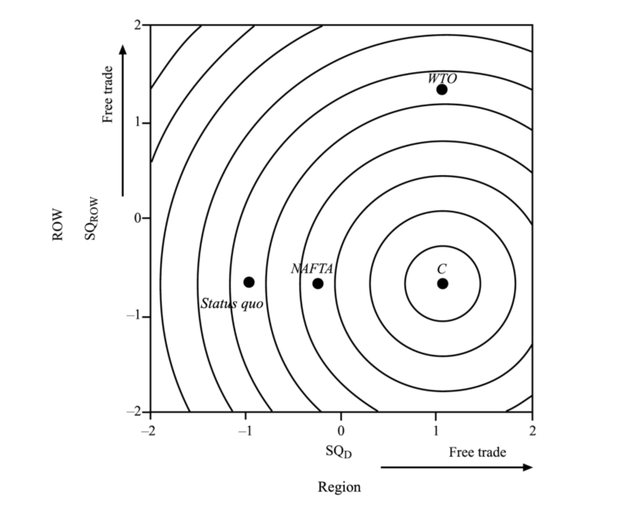
Forum Shopping (Busch 2007)
Complainant (C) prefers
(SQD, SQROW) = (1, –0.5)
Status quo is (-1, -0.5)
If goes to WTO, outcome is (1, 1.5)
If goes to NAFTA, outcome is (-0.1, -0.5)
So NAFTA is better than WTO
(closer to C’s ideal point).
The preference has two dimensions! (Region vs. ROW)
WTO is not ideal if C only wants regional liberalization.

Slide 44
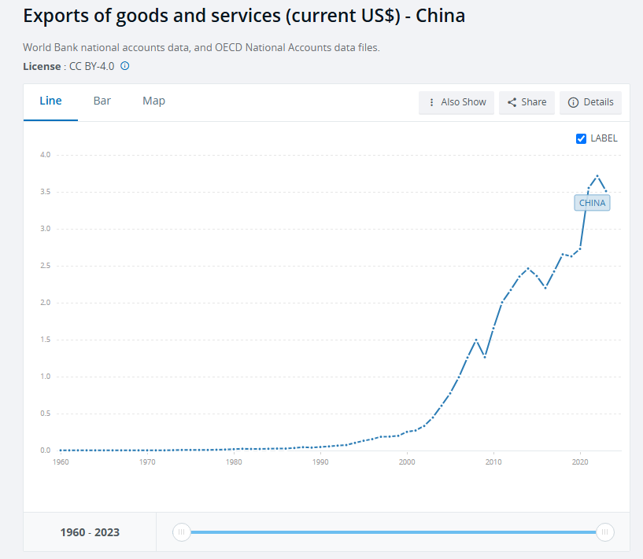
WTO and the “China Shock”
Notes:
https://data.worldbank.org/indicator/NE.EXP.GNFS.CD?locations=CN

